Slide 1
Smart Water Management
Development part-- 2
--By using Internet of things(IOT)

Slide 2
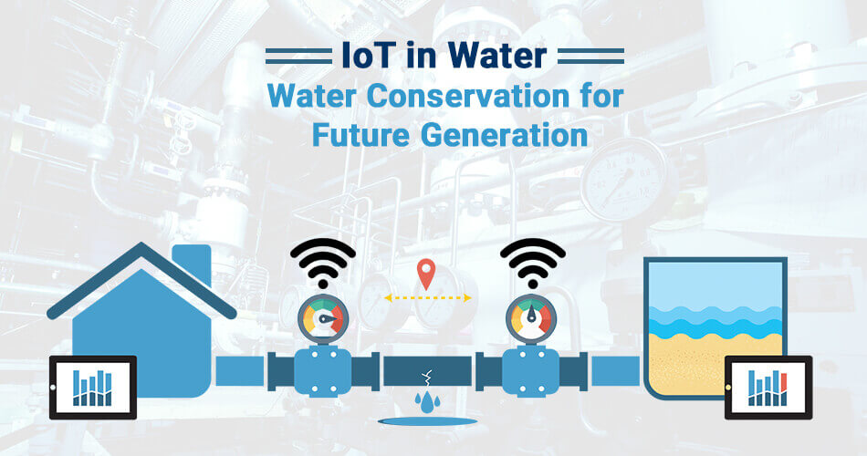

Slide 3
INTRODUCTION:
Water quality monitoring is a cost-effective, efficient system to monitor water quality using IoT.
Smart solutions for monitoring of water pollution are getting more and more significant these days with innovation in sensors, communication, and Internet of Things (IoT) technology.
Smart water management involves the efficient and sustainable utilization of water resources through the integration of technology, policies, and practices. This approach aims to optimize water usage, reduce waste, and ensure long-term water security. Key components include real-time monitoring systems, data analytics, water recycling, and the implementation of water-saving technologies. Additionally, community engagement, regulatory frameworks, and education play crucial roles in promoting responsible water management practices.

Slide 4
Certainly! When preparing a presentation on smart water management, it's important to cover key aspects such as the challenges of water scarcity, the importance of sustainable water use, and the role of technology in optimizing water resources. Here is a suggested outline for your presentation:
Introduction - Definition of smart water management - Importance of efficient water utilization.
2. Water Scarcity and Challenges - Global water scarcity statistics - Impact on the environment and human life - Current challenges in water management.
Sustainable Water Use Practices - Water conservation techniques - Importance of water recycling and reuse - Adoption of efficient irrigation methods.
4. Role of Technology - Real-time water monitoring systems - Data analytics for water resource optimization - Smart sensor technologies for leak detection .

Slide 5
5. Case Studies and Best Practices - Successful smart water management projects - Innovative approaches in different regions - Positive impacts on communities and the environment.
6. Community Engagement and Policies - Importance of public participation in water conservation - Role of regulatory frameworks in promoting responsible water use - Educational initiatives for raising awareness.

Slide 6
7. Future Outlook and Recommendations - Potential advancements in smart water management technology - Strategies for scaling up smart water management practices - Importance of global collaboration for sustainable water management.
8. Conclusion - Summarize the key points - Emphasize the significance of adopting smart water management practicesMake sure to include relevant visuals, diagrams, and case studies to illustrate your points effectively. Additionally, emphasize the economic, environmental, and social benefits of implementing smart water management strategies.

Slide 7
Using various sensor:
Smart water management sensors play a critical role in monitoring and controlling various aspects of water systems. These sensors can include,
1. Water quality sensors:
They assess parameters such as pH levels, salinity, dissolved oxygen, and pollutant concentrations to ensure water quality meets required standards.
2. Flow sensors:
They measure the flow rate of water, enabling efficient water distribution and detecting potential leaks or wastage.
3. Level sensors:
These sensors determine water levels in tanks, reservoirs, and other storage facilities, helping manage water supply and distribution effectively.
4. Weather sensors:
They monitor weather conditions like temperature, humidity, and rainfall, allowing for better water usage planning and irrigation management.
Integrating these sensors into a smart network enables real-time data collection and analysis, fostering informed decision-making and proactive water resource management.

Slide 8
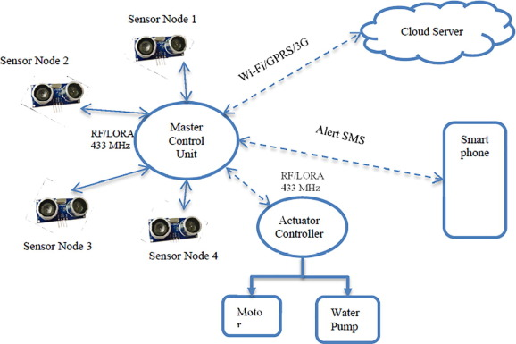
Master control unit:

Slide 9
Ph level sensor:
Maintaining a balanced pH level is crucial for effective water management. In general, the optimal pH level for most freshwater systems, including drinking water, is between 6.5 and 8.5. This range supports the survival of aquatic life and ensures the efficacy of water treatment processes.
However, it's important to note that specific pH requirements may vary depending on the type of water system and the intended use of the water. Regular monitoring and adjustment of pH levels are essential for ensuring the overall health and sustainability of water resources.

Slide 10
Water quality sensor:
Salinity levels in water are an important aspect of smart water management projects, particularly for agricultural and environmental purposes. Generally, the acceptable salinity range in water for irrigation and agricultural use varies depending on the crop type, but it typically falls within the range of 0.5 to 3 deciSiemens per meter (dS/m).
However, specific requirements may differ based on the specific crops being cultivated and the environmental conditions of the region. Regular monitoring of salinity levels and appropriate management strategies, such as using proper irrigation techniques and soil amendments, are vital to ensure the sustainability of water resources and the health of crops.

Slide 11
Most water that's acceptable for irrigation of landscapes contains 200 to 800 mg/L of dissolved salts. Total soluble salt levels up to 2,000 mg/L may be tolerated by certain plant species, but only on soils with exceptional permeability and subsoil drainage.
Managing salinity involves striking a balance between the volume of water entering (recharge) and leaving (discharge) the groundwater system. The water table can be lowered by: planting, regenerating and maintaining native vegetation and good ground cover in recharge, transmission and discharge zones, where possible.

Slide 12
Architecture of IOT based system:
IoT based water monitoring system consists of a controller, sensors, and an application to display the data. Lists various components of an IoT based water monitoring system.
The water management system can be broadly classified into two main categories namely water level monitoring systems and water quality monitoring systems.
Water level monitoring systems are those systems that attempt to measure in real-time the water level of a water reservoir using sensors.
The water quality monitoring system attempts to measure various water quality parameters like pH, conductivity, TDS, etc. value in the water by using different sensors.

Slide 13
Smart water management IoT projects typically incorporate various sensors and Internet of Things (IoT) devices to monitor and manage water usage efficiently. These projects often leverage technologies such as water flow sensors, water quality sensors, and smart meters to collect real-time data on water consumption, quality, and distribution.
IoT platforms then analyze this data to optimize water usage, detect leaks, and enable remote control of water systems. By integrating IoT solutions, these projects aim to enhance water conservation, reduce costs, and improve overall water resource management for both urban and agricultural settings.

Slide 14
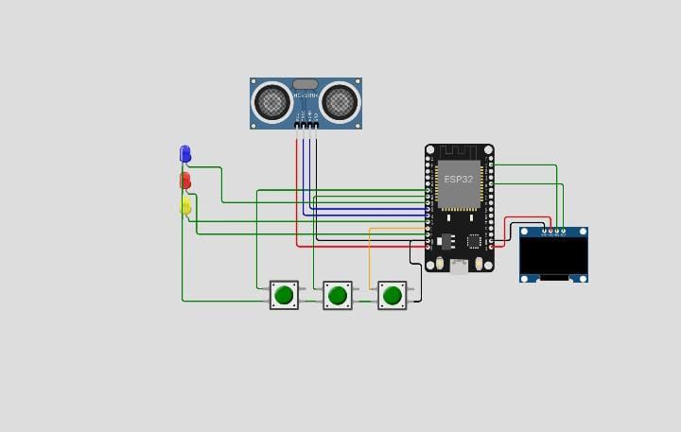
Sample circuit diagram:

Slide 15
Arduino:
Implementing smart water management using Arduino involves utilizing Arduino microcontrollers and various sensors to create an automated water management system. With Arduino, can develop projects such as automated irrigation systems, water quality monitoring, and water level control mechanisms. By integrating sensors like moisture sensors, flow sensors, and pH sensors with the Arduino platform, you can collect data on water usage, quality, and environmental conditions.
This data can then be used to automate watering schedules, detect leaks, and maintain optimal water levels, contributing to efficient water utilization and conservation.

Slide 16
Why we use ultrosonicc sensor for our project?
Ultrasonic sensors work based on the principle of sending and receiving high-frequency sound waves. These sensors typically consist of a transceiver, which can both send and receive ultrasonic waves. When the sensor sends out a burst of ultrasonic sound waves, they travel through the air until they encounter an object. The waves then bounce off the object and return to the sensor.
By measuring the time taken for the waves to return, the sensor can calculate the distance to the object. This information is used to determine the proximity or absence of an object in front of the sensor. Ultrasonic sensors are commonly used in applications such as distance measurement, object detection, and obstacle avoidance in various fields including automotive, manufacturing, and robotics.

Slide 17
Github link for web development page:
https://github.com/Santhiyaa-21/sam.git

Slide 18
Html coding for Monitor Water Quality level:
<!DOCTYPE html>
<html lang="en">
<head>
<meta charset="UTF-8" />
<meta name="viewport" content="width=device-width,
initial-scale=1.0" />
<title>Water Management</title>
</head>

Slide 19
<style>
#locationBlock {
flex-direction: row nowrap; display: flex;
gap: 150px;
box-shadow: 1px 4px 30px 1px; margin: 40px;
justify-content: center; } #parentElement { background-color: white;
}
#pumpButton {
padding: 10px;
padding-left: 20px;
padding-right: 20px;
background-color: blue;
border-radius: 15px 15px 15px 15px; margin-left: 20px;
color: whitesmoke;
font-weight: 600;
}

Slide 20
#Chennai {
color: black;
margin: 2px; }
#currentElement {
flex-direction: row nowrap; display: flex;
gap: 150px;
box-shadow: 1px 4px 30px 1px; margin: 40px;
justify-content: center;
}
#Header {
width: 100%;
display: flex;
justify-content: center;
flex-direction: row nowrap;
font-weight: 900;
font-size: xx-large;
color: gray;
}

Slide 21
</style>
<body onload="hideElement()"> <div id="Header">Water Management</div>
<div id="parentElement">
<div id="locationBlock">
<div id="Chennai">
<h3 id="chennaiCity">Chennai</h3> <p id="chennaiSensor">Sensor Data: 3</p>
<p
id="chennaiWaterLevel">Current Water Level(ft): 74.23</p> <button id="pumpButton" onclick="startPumping('Chennai')"> Start Pump
</button>
</div>

Slide 22
<div id="">
<h3 id="MaduraiCity">Madurai</h3> <p id="maduraiSensor">Sensor Data: 23.30</p>
<p
id="maduraiWaterLevel">Current Water Level(ft): 24.44</p> <button id="pumpButton" onclick="startPumping('Madurai')"> Start Pump
</button>
</div>

Slide 23
<div id="">
<h3 id="RamanathapuramCity">Ramanathapuram</h3>
<p id="ramnadSensor">Sensor Data: 16.19</p>
<p
id="ramnadWaterLevel">Current Water Level(ft): 2.05</p> <button id="pumpButton" onclick="startPumping('Ramanathapuram')">
Start Pump
</button>
</div>

Slide 24
<div id="">
<h3 id="TirunelveliCity">Tirunelveli</h3> <p
id="tirunelveliSensor">Sensor Data: 12.33</p>
<p id="tirunelveliWaterLevel">Current Water Level(ft): 12.03</p> <button id="pumpButton" onclick="startPumping('Tirunelveli')"> Start Pump
</button>
</div>
</div>

Slide 25
<div id="currentElement">
<p id="City"></p>
<p id="Sensor"></p>
<p id="WaterLevel"></p>
</div>
</div>
<script>
function startPumping(city) {
var _element = document.getElementById("currentElement");
_element.style.display = "block"; _element.style.display = "flex";

Slide 26
if (city === "Chennai") {
var _currentCity = document.getElementById("chennaiCity").innerHTML;
var _currentSensor = document.getElementById("chennaiSensor").innerHTML;
var _currentWaterLevel = document.getElementById("chennaiWaterLevel").innerHTML;
document.getElementById("City").innerHTML = _currentCity; document.getElementById("Sensor").innerHTML = _currentSensor; document.getElementById("WaterLevel").innerHTML = _currentWaterLevel;

Slide 27
} else if (city === "Madurai") { var _currentCity = document.getElementById("MaduraiCity").innerHTML;
var _currentSensor = document.getElementById("maduraiSensor").innerHTML;
var _currentWaterLevel = document.getElementById("maduraiWaterLevel").innerHTML;
document.getElementById("City").innerHTML = _currentCity; document.getElementById("Sensor").innerHTML = _currentSensor; document.getElementById("WaterLevel").innerHTML = _currentWaterLevel; } else if (city === "Tirunelveli") {

Slide 28
var _currentCity = document.getElementById("TirunelveliCity").innerHTML;
var _currentSensor = document.getElementById("tirunelveliSensor").innerHTML;
var _currentWaterLevel = document.getElementById("tirunelveliWaterLevel").innerHTML;
document.getElementById("City").innerHTML = _currentCity; document.getElementById("Sensor").innerHTML = _currentSensor; document.getElementById("WaterLevel").innerHTML = _currentWaterLevel; } else if (city === "Ramanathapuram") {

Slide 29
var _currentCity = document.getElementById("RamanathapuramCity").innerHTML;
var _currentSensor = document.getElementById("ramnadSensor").innerHTML;
var _currentWaterLevel = document.getElementById("ramnadWaterLevel").innerHTML;
document.getElementById("City").innerHTML = _currentCity; document.getElementById("Sensor").innerHTML = _currentSensor;

Slide 30
document.getElementById("WaterLevel").innerHTML = _currentWaterLevel;
}
}
function hideElement(){
}
</script>
</body>
</html>

Slide 31
Some key points about IBM Cloud Foundry:
*Platform as a Service (PaaS)*:
IBM Cloud Foundry is a PaaS offering that allows developers to build, deploy, and scale applications without the need to manage the underlying infrastructure. This enables developers to focus more on application development and less on infrastructure management.
2. *Language Support*:
It supports various programming languages, including Java, Node.js, Ruby, and others, providing developers with the flexibility to work with their preferred languages and frameworks

Slide 32
3. *Integration with IBM Services*:
IBM Cloud Foundry integrates seamlessly with various IBM services such as databases, AI, analytics, and security services, enabling developers to leverage a wide range of tools and resources within their applications.
4. *Scalability and Resilience*:
It provides automatic scaling and load balancing, ensuring that applications can handle increased traffic and demand. Additionally, it offers built-in features for high availability and resilience.
5. *Open Source Foundation*:
IBM Cloud Foundry is built on an open-source foundation, making it compatible with other Cloud Foundry distributions and allowing for community collaboration and contributions.

Slide 33
Using Raspberry Pi:
1. *Low-Cost Computer*:
Raspberry Pi is a series of small, affordable, single-board computers developed in the UK by the Raspberry Pi Foundation. It is designed to promote teaching basic computer science in schools and developing countries.
2. *Versatility*:
It can be used for various purposes, such as learning programming, building DIY projects, home automation, media centers, retro gaming consoles, and more.
3. *GPIO Pins*:
It comes with General Purpose Input/Output (GPIO) pins that allow it to connect with electronic components, making it suitable for physical computing and prototyping projects.

Slide 34
4. *Operating Systems*:
It supports various operating systems, including Raspbian (now Raspberry Pi OS), Ubuntu, and others, making it flexible for different types of projects.
5. *Community Support*:
There is a large and active community of Raspberry Pi enthusiasts who share ideas, projects, and troubleshooting tips, making it easier for beginners to get started and learn from others.

Slide 35
Using MIT app invertor for Web Development:
It seems like , might be referring to MIT App Inventor, which is a web-based integrated development environment (IDE) used to create Android applications. Here are some key points about MIT App Inventor:
1. *Visual Programming*:
MIT App Inventor allows users to create Android applications using a visual programming interface, making it accessible to those with little or no coding experience.
2. *Block-Based Coding*:
Instead of writing code, users drag and drop visual blocks that represent different functionalities and behaviors, simplifying the app development process.

Slide 36
3. *Educational Tool*:
MIT App Inventor is often used as an educational tool to introduce students to the fundamentals of programming and app development.
4. *Integration with Android Devices*:
It facilitates the testing of apps directly on Android devices using a companion app, which can be installed on smartphones or tablets.
5. *Community Support*:
MIT App Inventor has a thriving community where users can share their projects, seek help, and collaborate with others on app development.

Slide 37
Benefits of our project:
1. *Efficient Resource Utilization*: Optimized use of water resources leading to reduced wastage and improved conservation.
2. *Data-Driven Decision Making*: Access to real-time data for informed decision-making, leading to more effective and timely responses to water-related issues.
3. *Infrastructure Improvement*: Enhanced monitoring and management of water infrastructure, leading to better maintenance and longevity of the water supply system.
4. *Cost Savings*: Reduced operational costs due to the identification and mitigation of leaks, overflows, and other inefficiencies.

Slide 38
5. *Environmental Sustainability*: Promotes sustainable water use practices, which help in conserving natural resources and minimizing environmental impact.
6. *Improved Water Quality*: Enhanced monitoring and management can lead to improved water quality and reduced contamination risks.
7. *Community Engagement*: Encourages community involvement and awareness regarding water conservation and responsible usage.
8. *Resilience to Climate Change*: Better preparedness for and adaptation to the impacts of climate change on water resources through data-driven insights and adaptive strategies.

Slide 39
Applications of our project:
1. *Leak Detection and Prevention*: Utilizing sensors and data analysis to detect leaks in water pipelines and prevent water loss.
2. *Water Quality Monitoring*: Deploying sensors and technology to continuously monitor water quality parameters such as pH, turbidity, and contaminant levels.
3. *Automated Irrigation Systems*: Implementing smart irrigation systems that adjust water usage based on real-time weather data, soil moisture levels, and plant water needs.
4. *Demand Forecasting and Management*: Using data analysis to predict water demand patterns and adjust supply accordingly to prevent shortages or wastage.

Slide 40
5. *Real-Time Monitoring of Water Distribution Networks*: Tracking water flow and pressure in distribution networks to optimize the distribution process and identify potential issues promptly.
6. *Consumer Water-Usage Monitoring*: Providing consumers with tools to monitor their water usage, encouraging responsible consumption and conservation practices.
7. *Flood Management*: Utilizing smart technologies to monitor and manage water levels in rivers, reservoirs, and other water bodies to mitigate the risks of flooding.
8. *Wastewater Management and Treatment*: Implementing smart systems to monitor and optimize wastewater treatment processes, reducing environmental pollution and ensuring the safe disposal of wastewater.

Slide 41
Overview:
A smart water management project typically involves the integration of technology to monitor, conserve, and optimize water usage. It often includes elements like IoT sensors, data analytics, and automated systems to enhance water distribution, usage, and conservation.
The key objectives typically revolve around improving efficiency, reducing wastage, and promoting sustainability in water usage. These projects can encompass various aspects, including smart irrigation systems, leak detection, water quality monitoring, and real-time data analysis to ensure effective water resource management.

Slide 42
THE END

